Slide 1
Executive Summary Outline for Stratethon 4
Reducing hospitalization (and re-hospitalization) risk through the early intervention program
Presenting an idea for Heart-health monitoring system
Team Name :
Campus:
Binary Twins, Jamia Millia Islamia

Slide 2
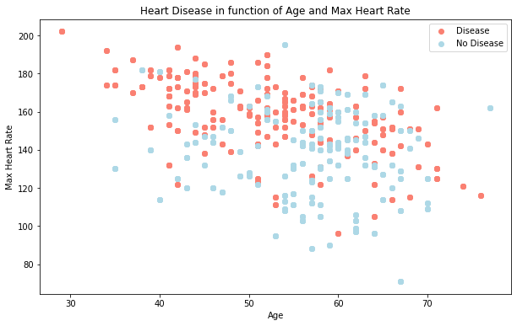
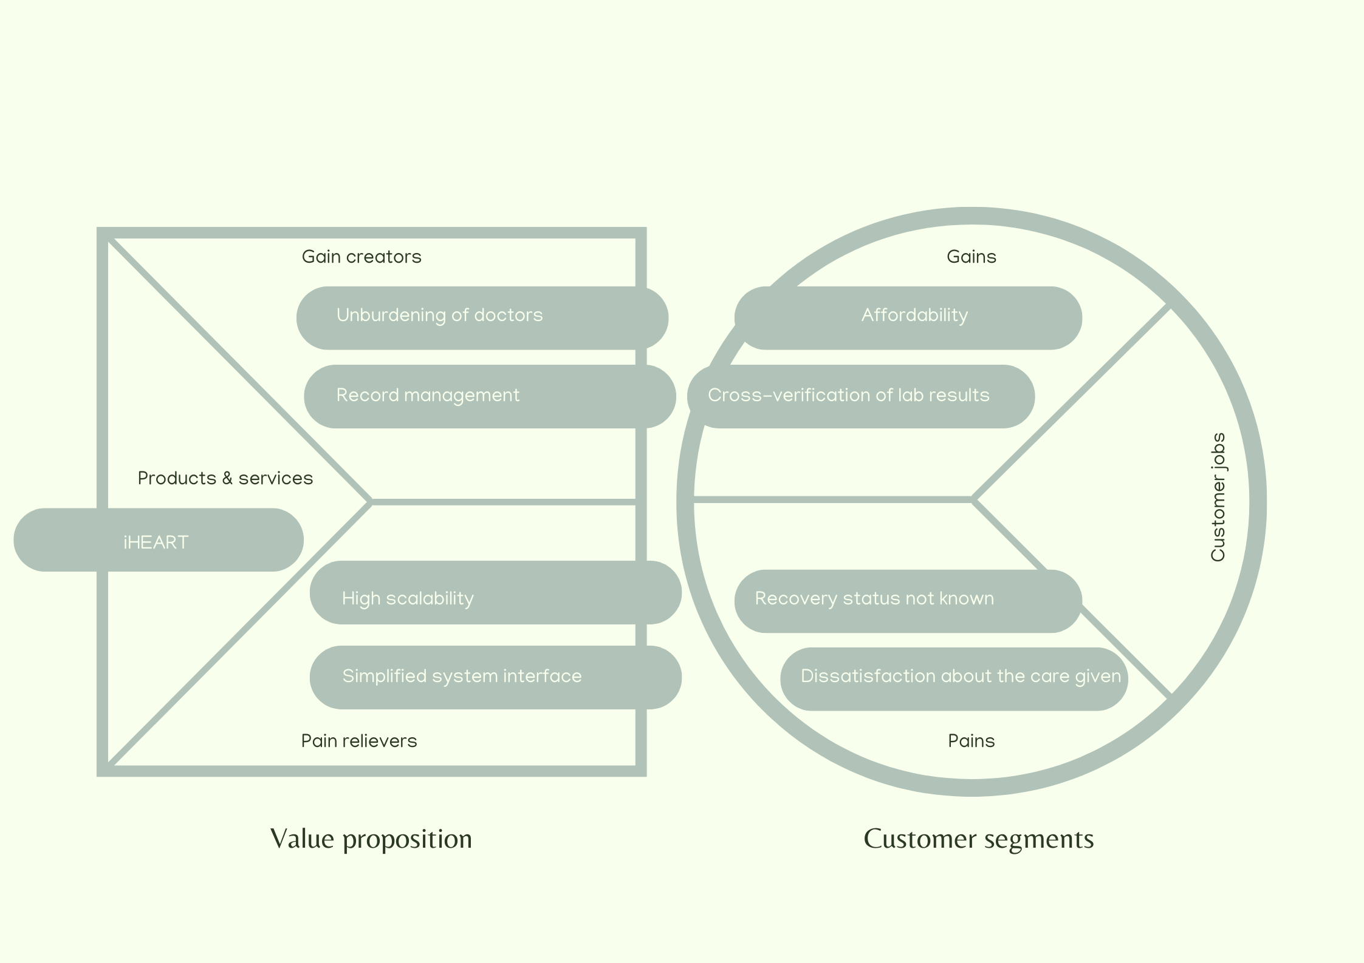
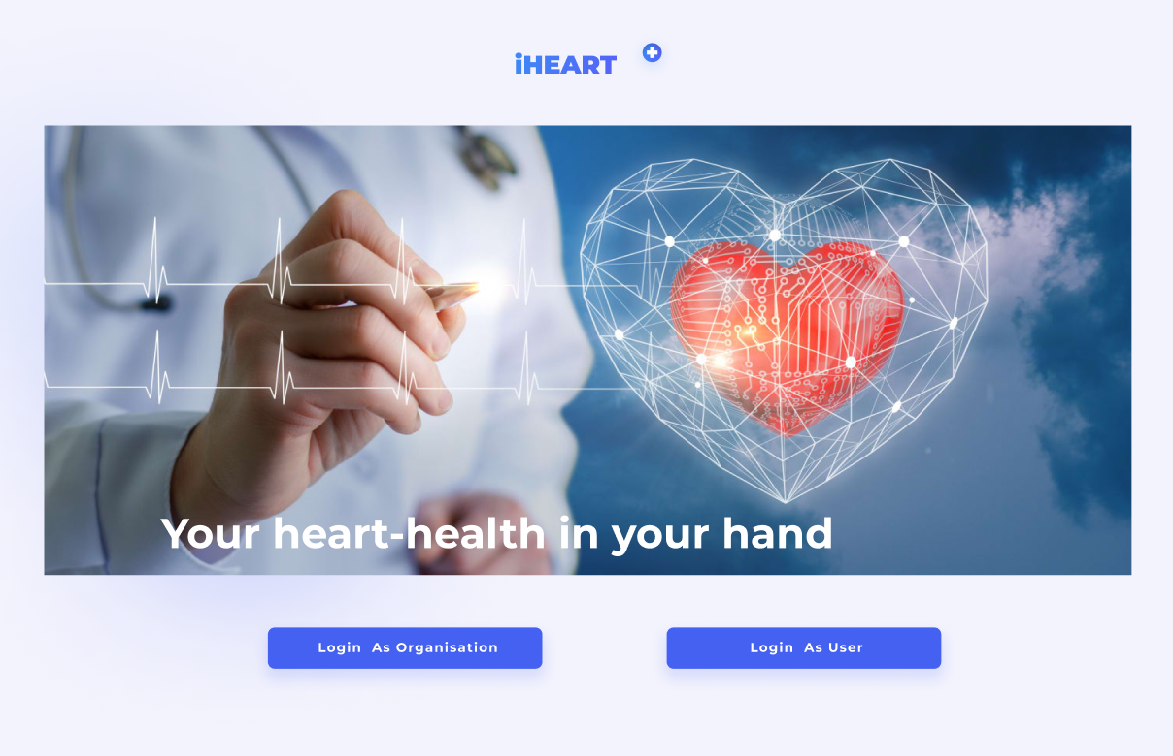
Business Problem & Solution
Lack of validated tools to assess potential disease progression and hospitalization decisions for cardiovascular diseases.
Difficulty in avoiding re-hospitalization which is related to therapeutic errors and failed handoffs.
Patients dissatisfaction with the medical care service provided.
Solution:
Presenting a heart-health monitoring system ‘iHEART’ which can be used by both hospitals and customers. Our approach employs highly intuitive UI and relieves users from their concerns about the manifestation of heart diseases post-covid. 13 important parameters ( are used to for performing analysis and the results are validated using accuracy and confusion matrix. The analysis pinpoints the risk factors and recommends the tests such as CT scan, angiogram later.

Slide 3
Thank you

